Slide 1
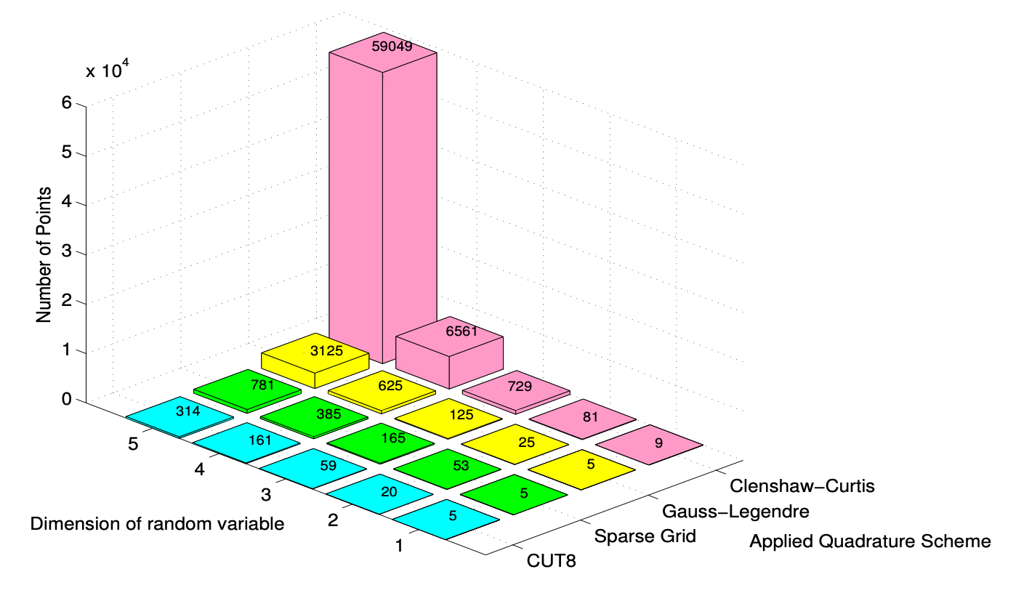
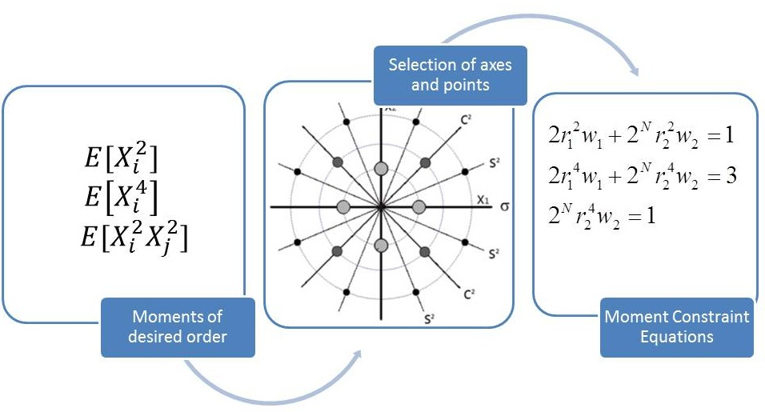
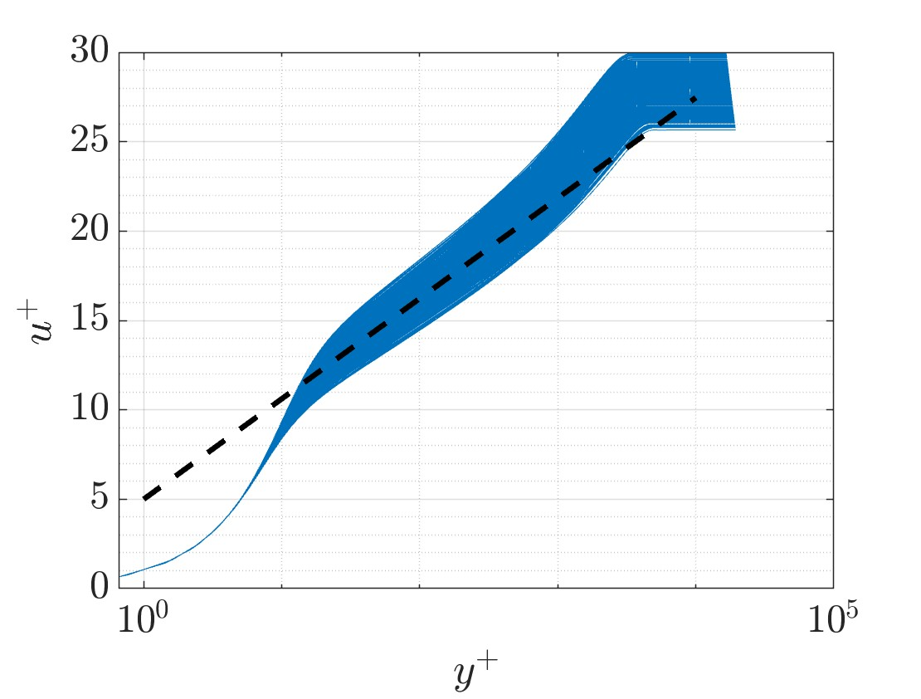
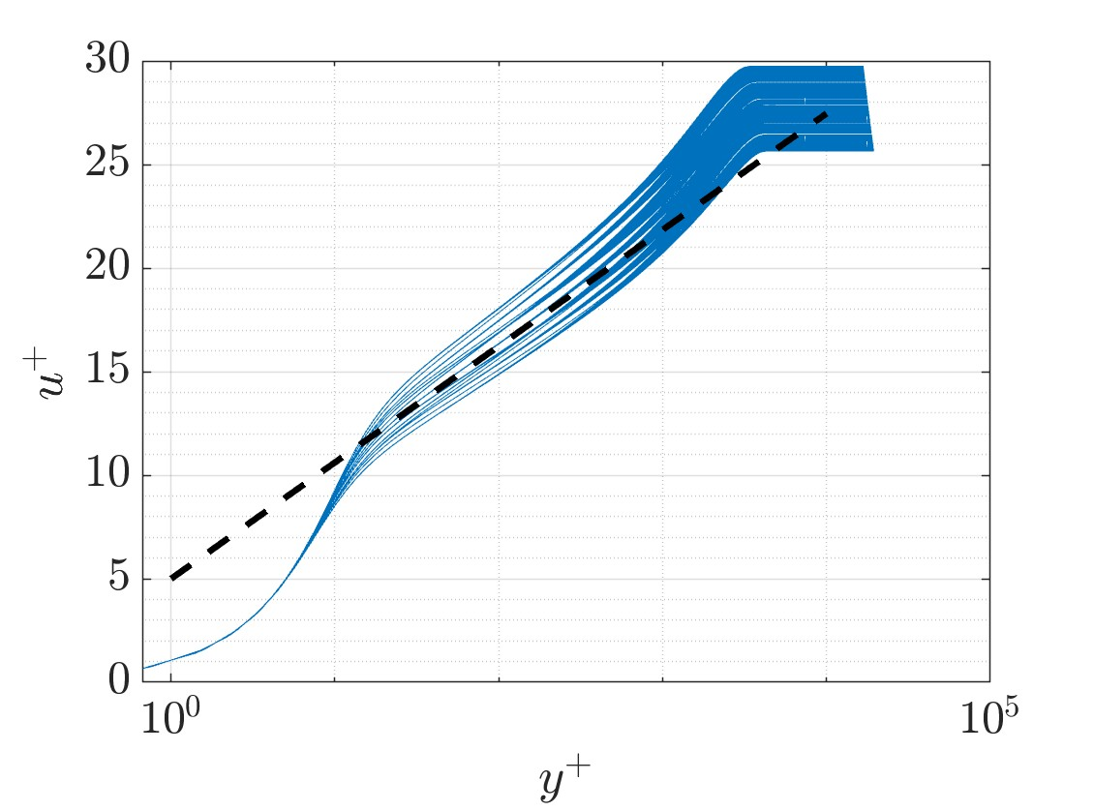
The Conjugate Unscented Transform for Uncertainty Quantification of the Spalart-Allmaras Turbulence Model
Uncertainty Quantification (UQ) is critical to understand how input variations affect a model’s outputs
The Conjugate Unscented Transform (CUT) has shown its capability to account for uncertainty while limiting the computational requirement
  Extension of Unscented Transform (UT), higher order
  Fewer sampling points than Monte Carlo (MC) or quadrature schemes to achieve similar accuracy
Spalart-Allmaras (SA) turbulence model used as test case in applicability to Computational Fluid Dynamics (CFD) modeling uncertainty
  Two test cases: 2D Mixing Layer and Turbulent Boundary Layer
  Across both cases, CUT consistently demonstrated improved accuracy relative to LHS for equivalent sample counts
Latin Hypercube Sampling
Conjugate Unscented Transform
Samuel Gosin, Ryan Glenn, Christopher Axten, James Coder, Puneet Singla

